Slide 1
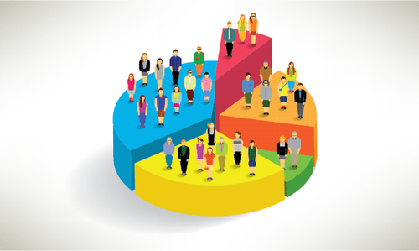

Customer Segmentation
Daniele Filippini
Scalable & Cloud Programming
2020/2021
daniele.filippini2@studio.unibo.it

Slide 2
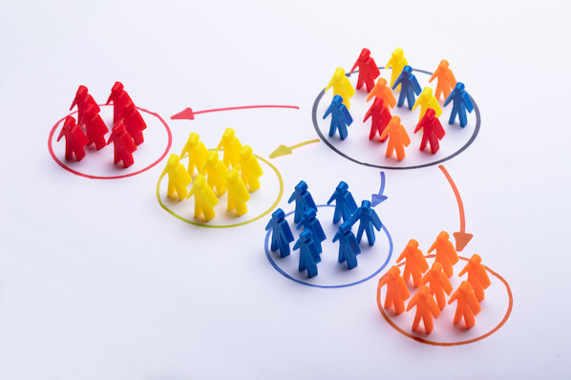
Introduction
Customer segmentation is the practice of dividing a company’s customers into groups that reflect similarity among customers in each group. The goal of segmenting customers is to decide how to relate to customers in each segment in order to maximize the value of each customer to the business by addressing each customer in the most effective way.
Machine learning customer segmentation allows advanced algorithms to surface insights and groupings that marketers might find difficulty discovering on their own.
However, as the size of the datasets is extremely large in many real cases, parallel processing of complex data analysis becomes indispensable.
MapReduce is a desirable distributed parallel programming paradigm for data intensive applications, based on shared-nothing architectures. Due to its simplicity, MapReduce can effectively handle failures and thereby can be scaled to thousands of nodes, making it feasible to compute on large scale datasets.
The objectives of the project are: build, test and analyse some of the most common machine learning clustering algorithms with their distributed implementation in the field of customer segmentation and compare their results.

Slide 3
Outline
Clustering Algorithms
RFM model
Datasets
Data Preprocessing
Experimental Studies
Conclusions

Slide 4
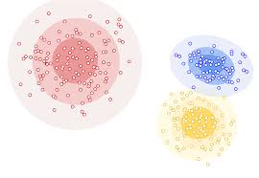
Clustering
Clustering is an unsupervised machine learning task. It involves automatically discovering natural grouping in data. Unlike supervised learning, clustering algorithms only interpret the input data and find natural groups or clusters in feature space, there is no class to be predicted.
A cluster is often an area of density in the feature space where examples from the domain are closer to the cluster than other clusters (degree of similarity).
Clustering can be helpful as a data analysis activity in order to learn more about the problem domain, so-called pattern discovery.
There are different clustering algorithms, each of them offers a different approach to the challenge of discovering natural groups in data. There is no best clustering algorithm and no easy way to find the best algorithm for the data without using controlled experiments.

Slide 5
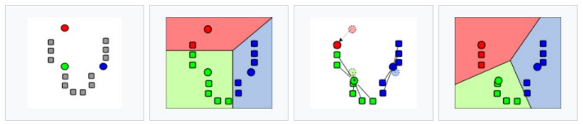
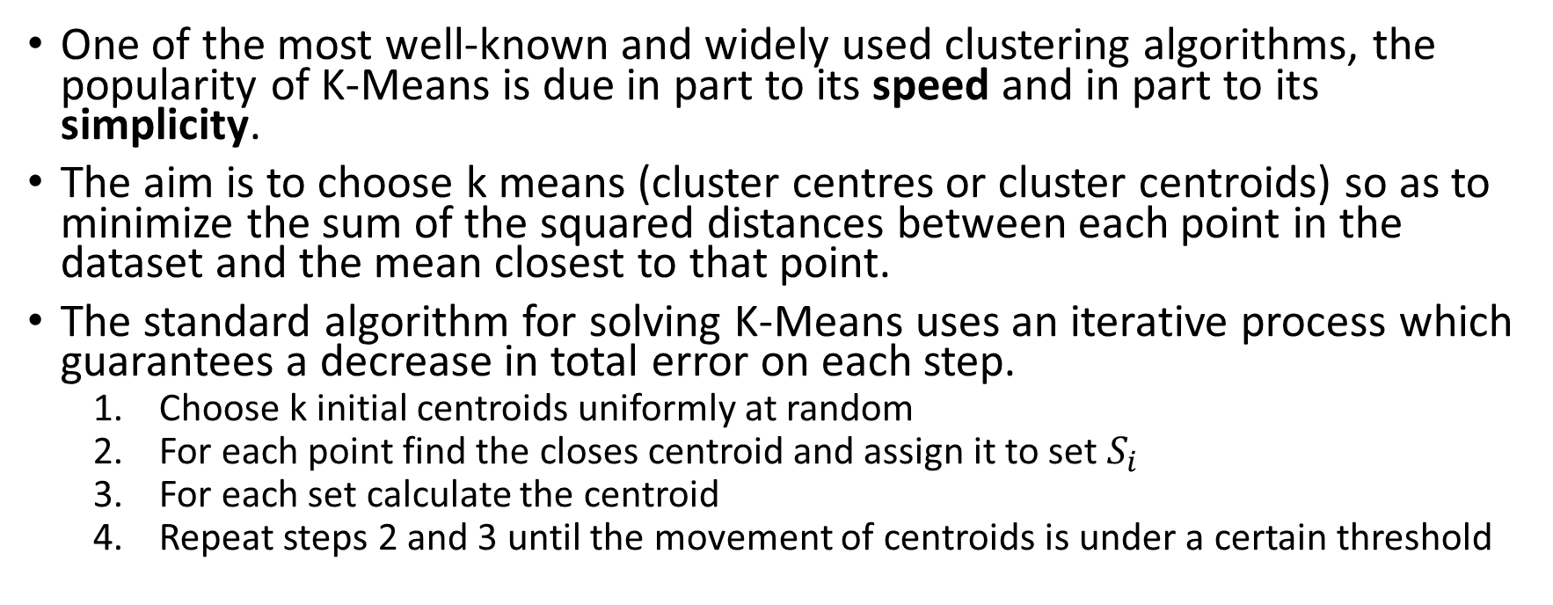
K-Means
One of the most well-known and widely used clustering algorithms, the popularity of K-Means is due in part to its speed and in part to its simplicity.
The aim is to choose k means (cluster centres or cluster centroids) so as to minimize the sum of the squared distances between each point in the dataset and the mean closest to that point.
The standard algorithm for solving K-Means uses an iterative process which guarantees a decrease in total error on each step.
Choose k initial centroids uniformly at random
For each point find the closes centroid and assign it to set $S_{i}$
For each set calculate the centroid
Repeat steps 2 and 3 until the movement of centroids is under a certain threshold

Slide 6
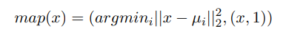
Distributed K-Means
Each iteration of the standard K-Means can be divided into two phases, the first that assigns each point to a cluster and the second that takes all the data points assigned to a cluster and uses that points to update the cluster centre.
These two phases correspond to the Map and Reduce phases of the MapReduce approach. The Map phase operates on each point x and computes the squared distance between x and each centroid to find the centroid which minimizes the distance. Then a key-value pair is emitted with the centroid index and the value (x, 1). The Reduce phase is just a straightforward pairwise summation over the values for each key.

Slide 7
K-Means||
The K-Means algorithm has maintained its popularity even as datasets have grown in size. the speed and simplicity of K-Means cannot be beat.
Therefore, recent work has focused on improving the initialization procedure: deciding on a better way to initialize the clustering dramatically changes the performance of the Lloyd’s iteration, both in terms of quality and convergence properties.
K-Means++ is a new algorithm that selects only the first center uniformly at random from the data, each subsequent center is selected with a probability proportional to its contribution to the overall error given the previous selections. The initialization algorithm exploits the fact that a good clustering is relatively spread out, thus when selecting a new cluster center, preference should be given to those further away from the previously selected centers.

Slide 8
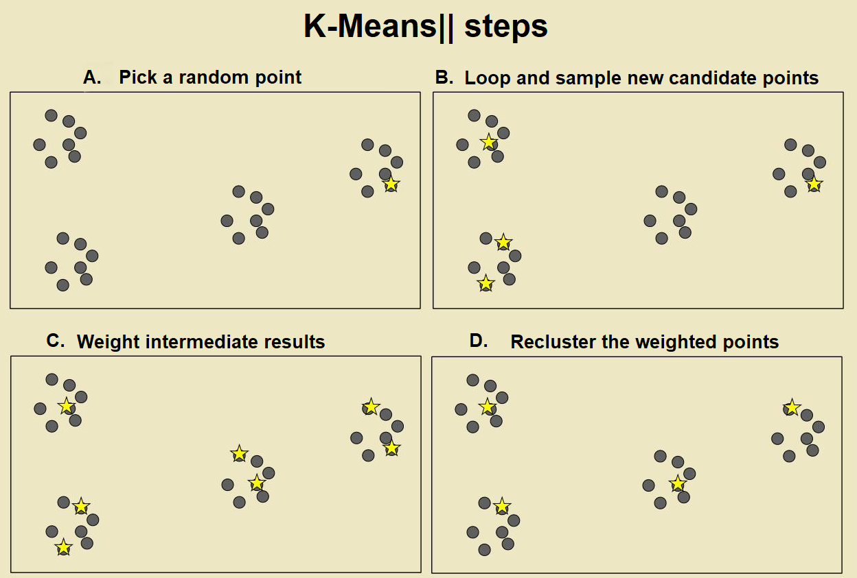
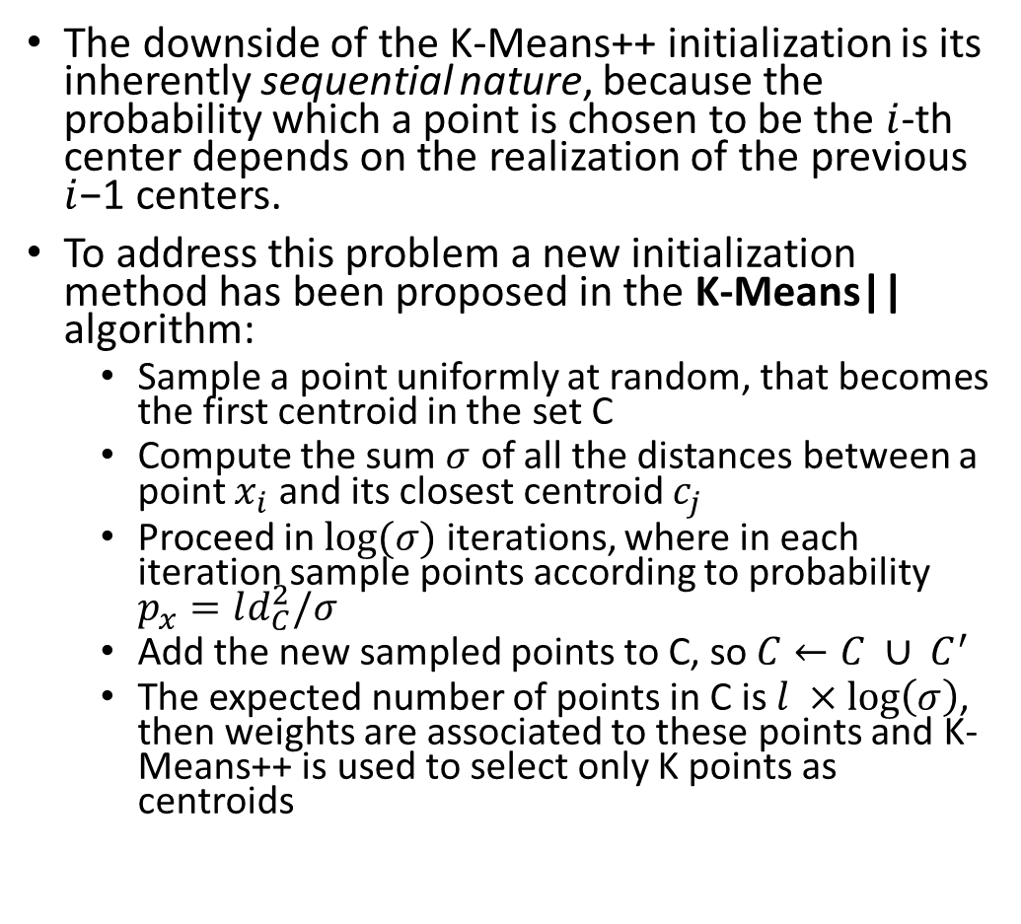
K-Means||
The downside of the K-Means++ initialization is its inherently sequential nature, because the probability which a point is chosen to be the $i$-th center depends on the realization of the previous $i$−1 centers.
To address this problem a new initialization method has been proposed in the K-Means|| algorithm:
Sample a point uniformly at random, that becomes the first centroid in the set C
Compute the sum $σ$ of all the distances between a point $x_{i}$ and its closest centroid $c_{j}$
Proceed in $log⁡(σ)$ iterations, where in each iteration sample points according to probability $p_{x}=ld_{C}^{2}/σ$
Add the new sampled points to C, so $C←C ∪ C^{′}$
The expected number of points in C is $l ×\log\left(σ\right)$, then weights are associated to these points and K-Means++ is used to select only K points as centroids

Slide 9
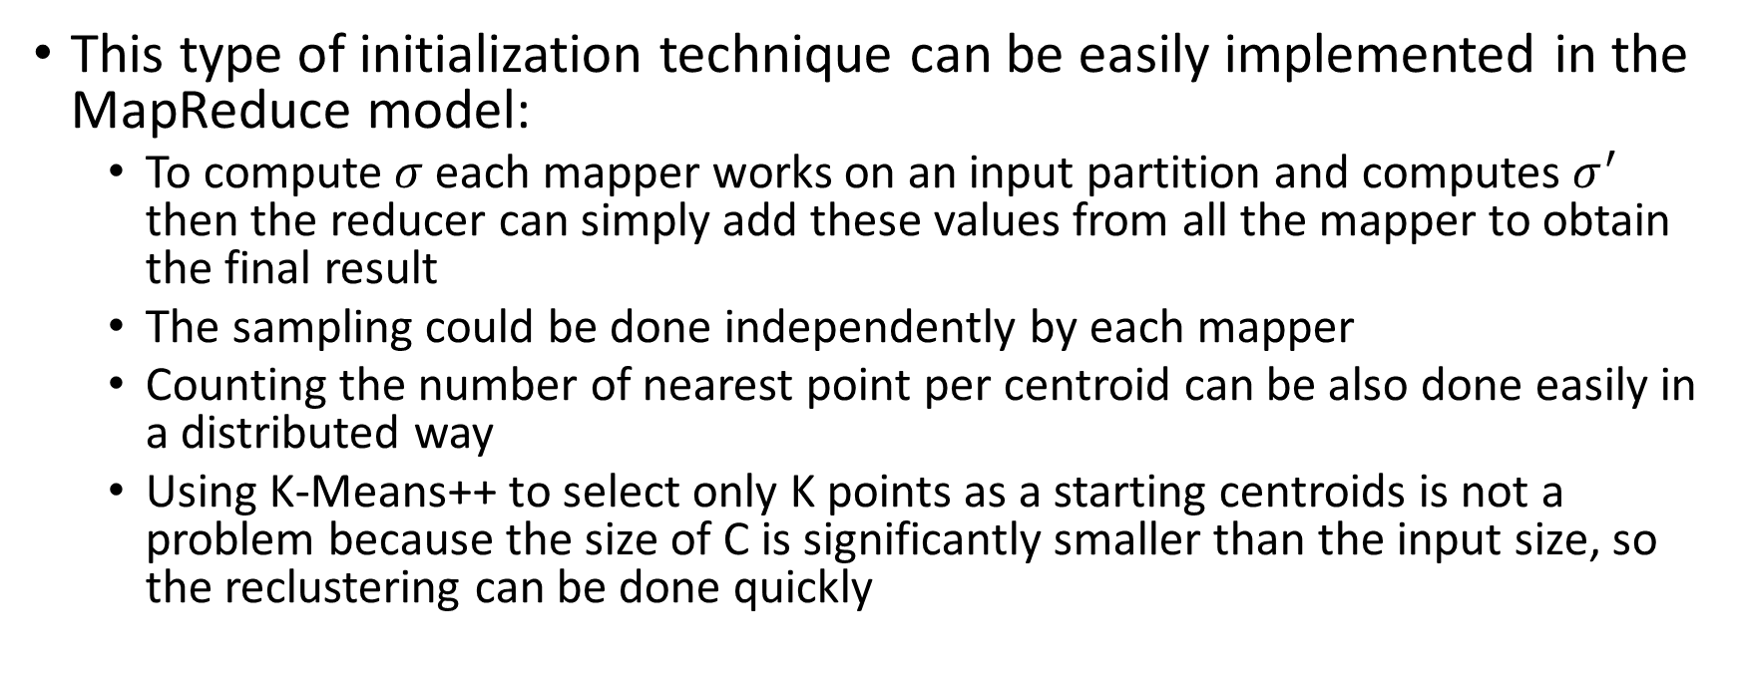
K-Means||
This type of initialization technique can be easily implemented in the MapReduce model:
To compute $σ$ each mapper works on an input partition and computes $σ^{′}$ then the reducer can simply add these values from all the mapper to obtain the final result
The sampling could be done independently by each mapper
Counting the number of nearest point per centroid can be also done easily in a distributed way
Using K-Means++ to select only K points as a starting centroids is not a problem because the size of C is significantly smaller than the input size, so the reclustering can be done quickly

Slide 10
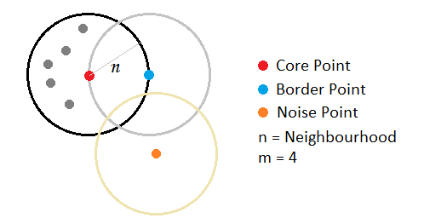
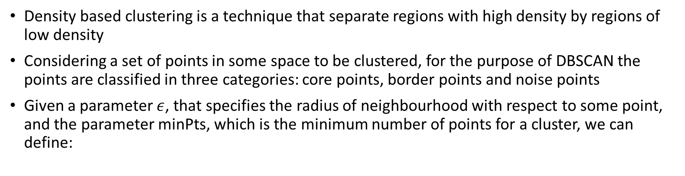
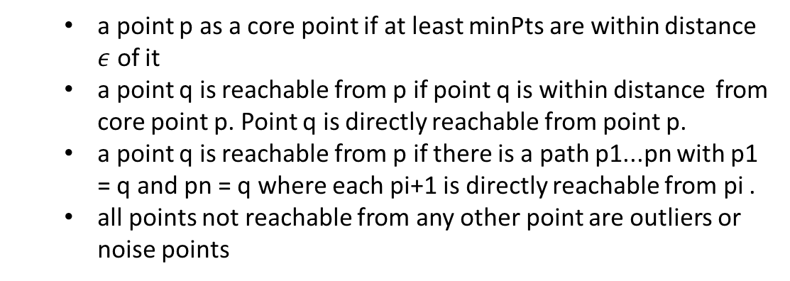
DBSCAN
Density based clustering is a technique that separate regions with high density by regions of low density
Considering a set of points in some space to be clustered, for the purpose of DBSCAN the points are classified in three categories: core points, border points and noise points
Given a parameter $ε$, that specifies the radius of neighbourhood with respect to some point, and the parameter minPts, which is the minimum number of points for a cluster, we can define:
a point p as a core point if at least minPts are within distance $ε$ of it
a point q is reachable from p if point q is within distance from core point p. Point q is directly reachable from point p.
a point q is reachable from p if there is a path p1...pn with p1 = q and pn = q where each pi+1 is directly reachable from pi .
all points not reachable from any other point are outliers or noise points

Slide 11
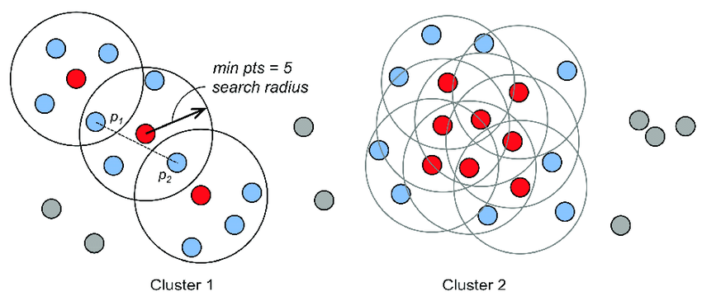
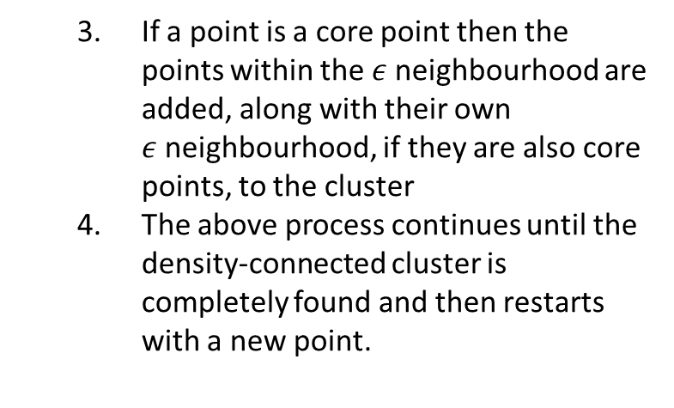
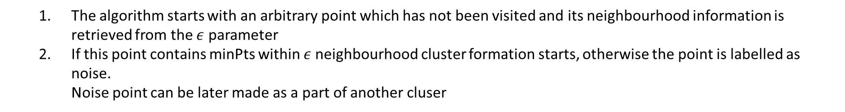
Local DBSCAN
If p is a core point, then it forms a cluster with all points (core and non-core) that are reachable from it.
The DBSCAN algorithm can be represented with the following steps:
The algorithm starts with an arbitrary point which has not been visited and its neighbourhood information is retrieved from the $ε$ parameter
If this point contains minPts within $ε$neighbourhood cluster formation starts, otherwise the point is labelled as noise.
Noise point can be later made as a part of another cluser
If a point is a core point then the points within the $ε$neighbourhood are added, along with their own $ε$neighbourhood, if they are also core points, to the cluster
The above process continues until the density-connected cluster is completely found and then restarts with a new point.

Slide 12
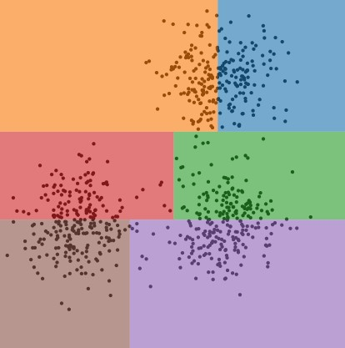
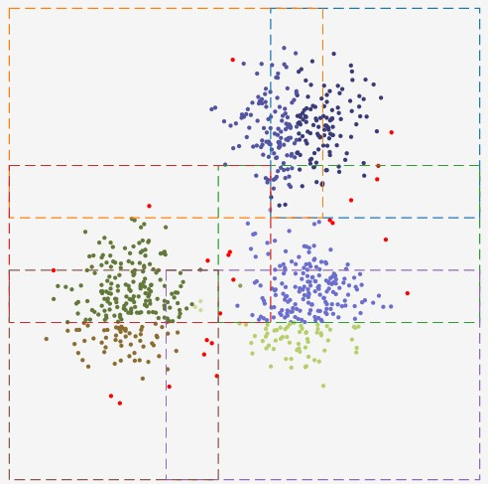
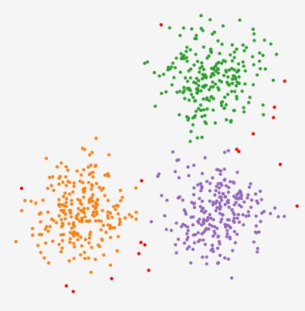
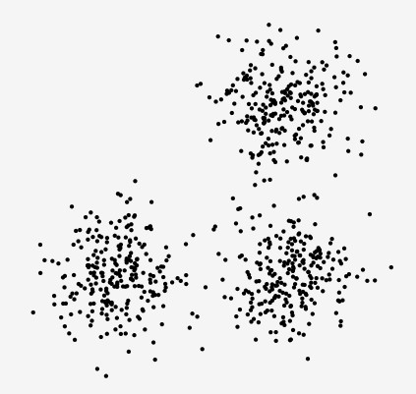
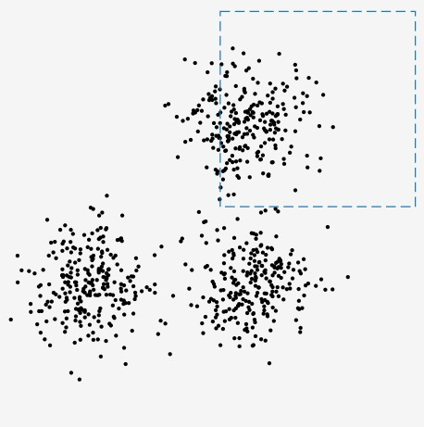
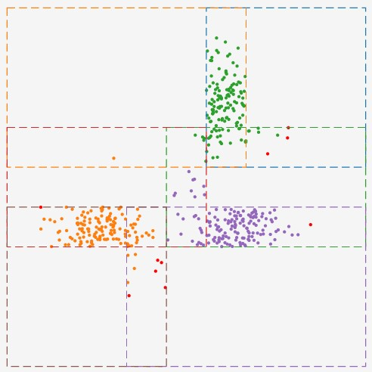
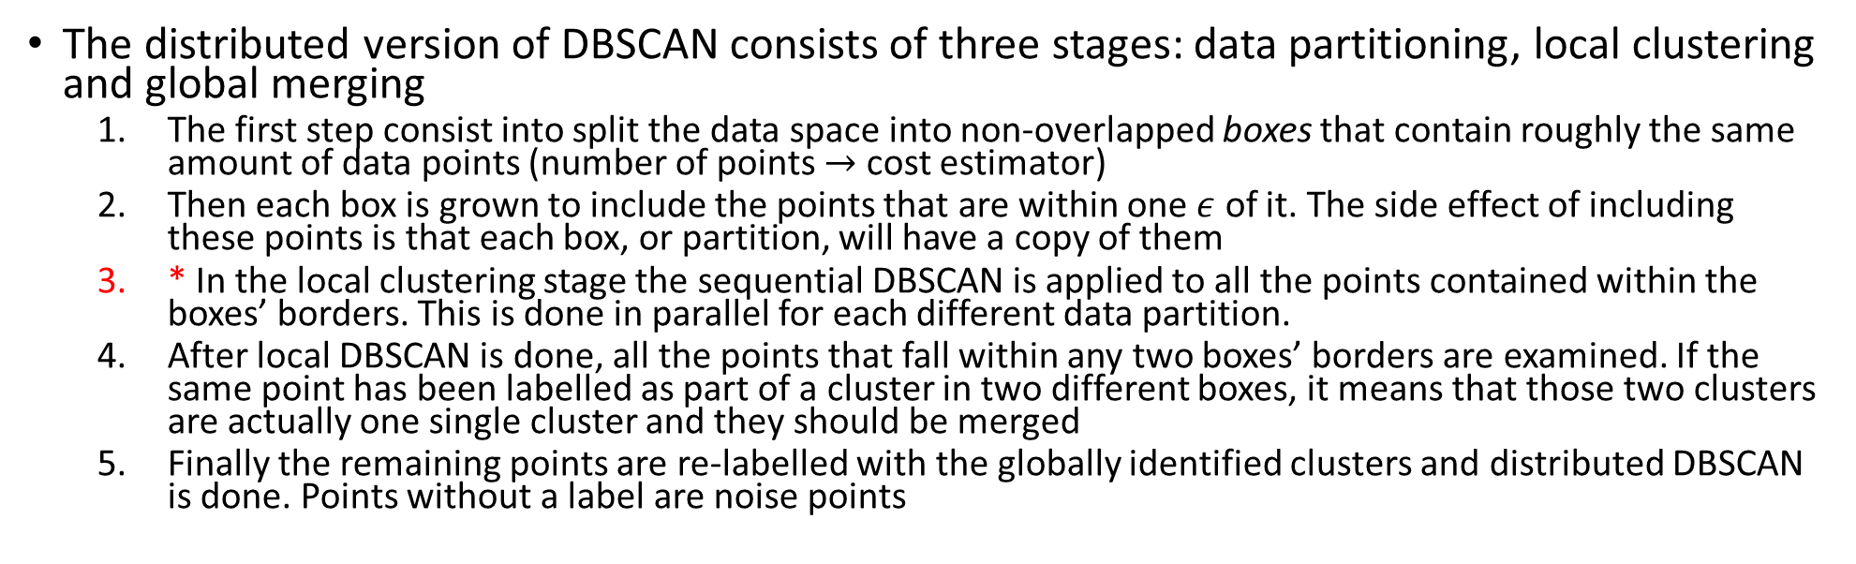
Distributed DBSCAN
* Dominant part of the whole process in term of computational time
The distributed version of DBSCAN consists of three stages: data partitioning, local clustering and global merging
The first step consist into split the data space into non-overlapped boxes that contain roughly the same amount of data points (number of points $→$ cost estimator)
Then each box is grown to include the points that are within one $ε$ of it. The side effect of including these points is that each box, or partition, will have a copy of them
* In the local clustering stage the sequential DBSCAN is applied to all the points contained within the boxes’ borders. This is done in parallel for each different data partition.
After local DBSCAN is done, all the points that fall within any two boxes’ borders are examined. If the same point has been labelled as part of a cluster in two different boxes, it means that those two clusters are actually one single cluster and they should be merged
Finally the remaining points are re-labelled with the globally identified clusters and distributed DBSCAN is done. Points without a label are noise points

Slide 13
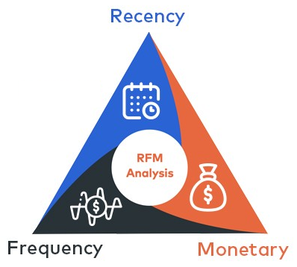
RFM model
A typical way to approach customer segmentation is to conduct RFM analysis
RFM stands for Recency, Frequency, and Monetary value, each corresponding to some key customer trait. These RFM metrics are important indicators of the customer’s behaviour because frequency and monetary value affects the customer’s lifetime value, and recency affects retention, a measure of engagement.
Recency: the freshness of the customer activity, e.g. time since the last order
Frequency: the frequency of the customer transactions or visits, e.g. total number of transactions or average time between transactions
Monetary Value: the intention of the customer to spend or purchasing power of customer, e.g. total transactions value

Slide 14
Datasets
There is no a benchmark dataset for customer segmentation available online, maybe due to the valuable value that such data have for companies and to privacy policy restrictions.
For the experimental studies three different dataset have been used, these datasets contains orders from customers to e-commerce sites, without any personal information about the users.
Online Retail dataset: contains all the transactions occurring for a UK-based and registered, non-store online retail between 01/12/2009 and 09/12/2011. The number of samples is 1.067.371 each of which represents different product purchases, the number of different users is 5.881
Instacart dataset: contains information about orders to a grocery shopping service. There are more than 3 million of samples from more than 200.000 Instacart users, however, there are no information about the price or the exact timestamp of the order
Multi Category Shop dataset: contains behaviour data from 7 months (from October 2019 to April 2020) from a large multi-category online store. Each sample of the dataset represents an event that is related to a product and a user, such as view, cart, remove from cart and purchase. The number of total users that purchased something is about 2 million

Slide 15
Data preprocessing
The datasets are not directly built to do customer segmentation, but are available to deal with different tasks, such as multivariate analysis, time-series analysis to predict the next purchase, etc.
RFM model to define features:
Recency: made by taking the last transaction date plus one day as reference date and we computed the number of days before that reference date when a customer made its last purchase. In the case of Instacart we take the number of days between two orders per customer, that is present in the original data
Frequency: number of different orders per customer
Monetary Value: made by taking the sum of all the money spent in each transaction made by an user. In the case of Instacart this is given by the average number of products in customer’s orders (the general assumption is that the size of an order might have something to do with its monetary value)
Feature scaling: since the proposed algorithms work with distance measures we have standardized the data, to ensure that different ranges of values does not cause poor performances and also the log scaling has been applied to have a distribution more similar to the Gaussian one.

Slide 16
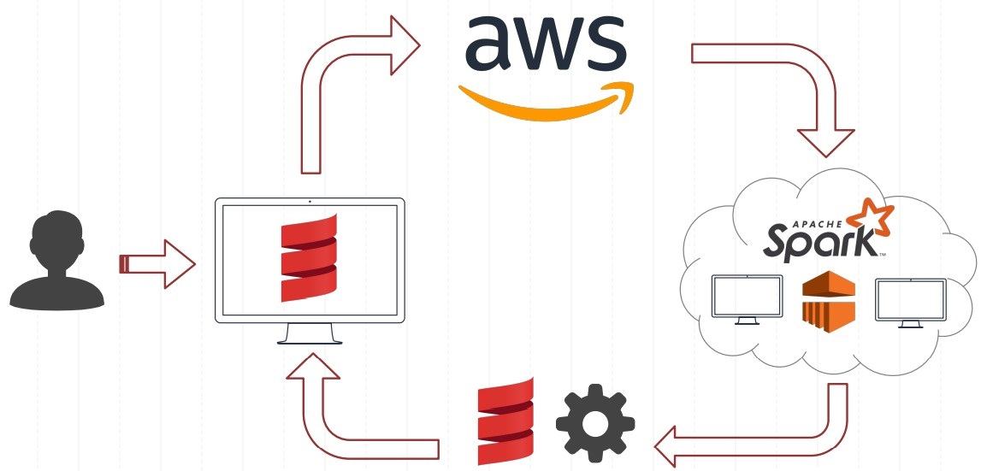





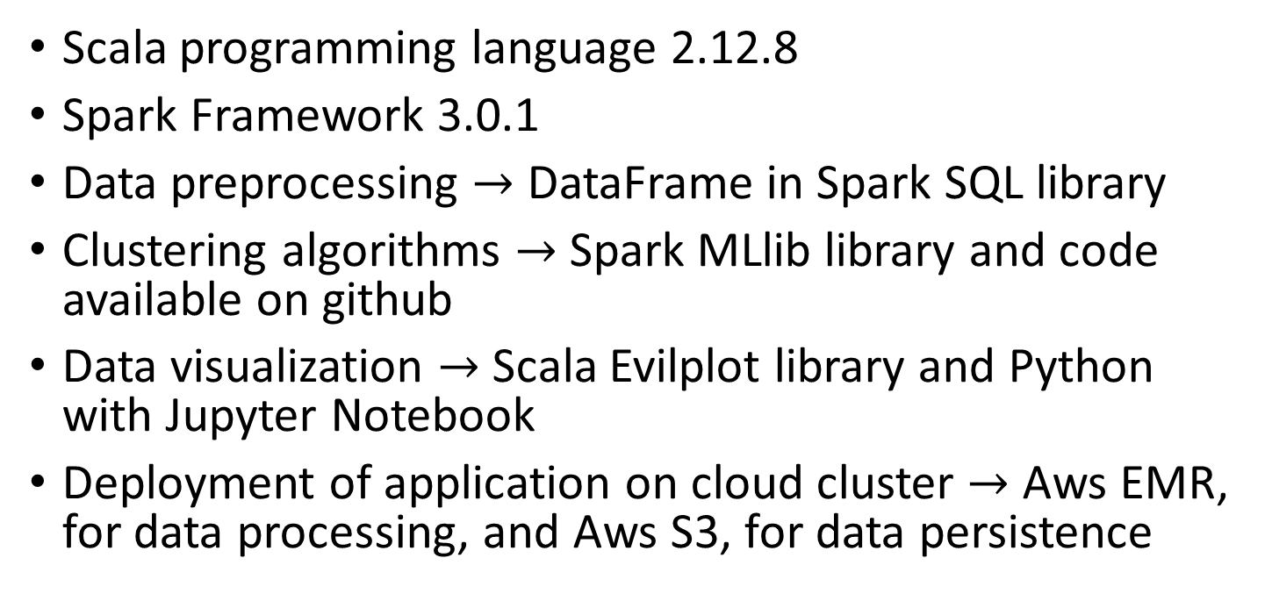
Experimental Setting
Scala programming language 2.12.8
Spark Framework 3.0.1
Data preprocessing $→$ DataFrame in Spark SQL library
Clustering algorithms $→$ Spark MLlib library and code available on github
Data visualization $→$ Scala Evilplot library and Python with Jupyter Notebook
Deployment of application on cloud cluster $→$ Aws EMR, for data processing, and Aws S3, for data persistence

Slide 17
Experimental Studies
In the experimental studies different algorithms and different implementations have been tested:
Standard K-Means implemented ”by-hand” using different Scala language built-in functions, to compare the efficiency of them;
Standard K-Means implemented in MLlib;
K-Means|| also implemented in MLlib;
Distributed DBSCAN implemented using available library on github;
To compare the algorithms and the different runs of the same algorithm we will use time (in milliseconds, 1.000ms = 1s, 3.600.000ms = 1h), but we consider only the time spent in computing the clusters (e.g. computing centroids and associate each point to the nearest centroid). Loading of files, plotting clusters and save the results in csv files are not considered in time computation.

Slide 18
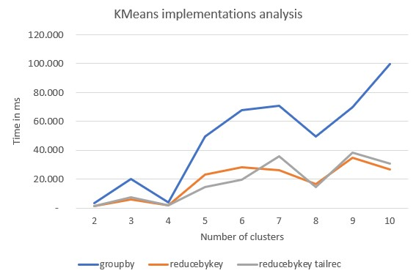
Experiment 1 – K-Means «by-hand» implementations
Analysis of the computational cost of different implementations of the K-Means algorithm using a synthetic file with 100.000 samples, created starting from 4 initial 2D points
Spark in local mode with an arbitrary number of threads has been used
An average of 10 runs has been made to compute the time needed (results are not influenced by the starting random points that are chosen at the beginning)

Slide 19
Experiment 1 – K-Means «by-hand» implementations
the first implementation uses the Scala built-in function groupBy inside a while loop to compute the centroids. This is clearly the most expensive solution it’s needed more computational time in combining the results in the main worker (it would cause a great amount of shuffling if executed on cloud).
the second implementation uses Scala built-in function reduceByKey inside a while loop to compute the centroids. This is a less expensive solutions because data are combined in each partition and only one output for one key at each partition needs to be send over the network, reducing the shuffling and augmenting the parallel computation. The difference w.r.t. the first solution is huge, especially when the number of cluster is higher. The ”groupBy model” seems to have an exponential cost as the number of cluster increment.
the third solution uses, as before, the built-in reduceByKey, but in this case following the functional approach a recursive implementation replaces the while loop. From the line plot we can see that the computational time is similar to the previous solution, for this reason we can say that ”looping” and ”recursive” solutions are equivalent.

Slide 20
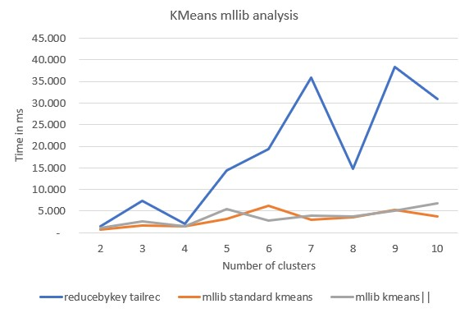
Experiment 2 – K-Means MLlib models analysis
After the analysis of K-Means algorithm implemented ”by-hand”, we compared the results of the ”reduceByKey model” with those obtained by using the Spark library Mllib, in local mode on the synthetic dataset
The difference is great especially in the case of high number of clusters
MLlib implementations are more efficient
The two models of standard K-Means and K-Means|| need almost the same time in all the cases
This could be due to points distributions, the better initialization given by the K-Means|| is not necessary in case the clusters are clearly separable

Slide 21
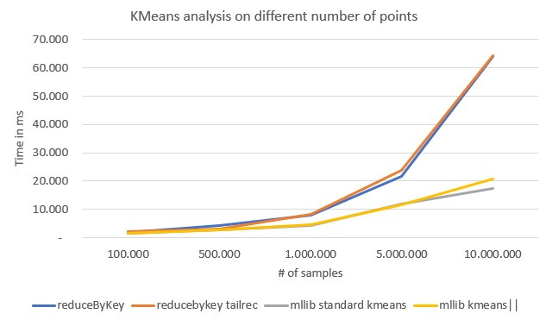
Experiment 3 – K-Means «by-hand» vs MLlib
Analysis of K-Means algorithms with different numbers of samples (synthetic datasets), in local mode
From this third analysis of the K-Means algorithms we can see that increasing the number of samples, not surprisingly, means higher computational time needed to find the cluster centres.
The difference between the implementations of Spark MLlib and the other two increases as the number of observations became higher and higher. Also from here, we can see that the difference between standard K-Means and K-Means|| is not high.

Slide 22
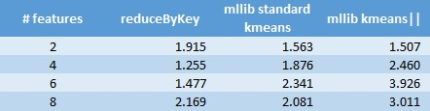
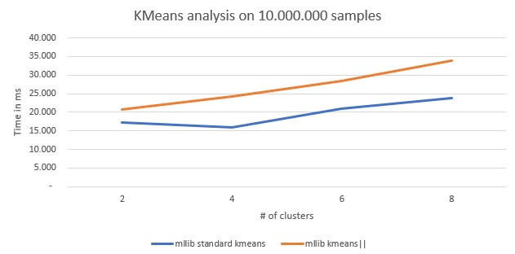
Experiment 4 – Increasing number of features
Analysis of performance on synthetic datasets with different number of features, in local mode
The table shows that with 100.000 samples the time needed to compute the clusters does not varies a lot, we can only observe a very little increment
Increasing the number of dimensions when the number of points is higher (10 million) means more computational time needed to compute the cluster centres.
MLlib standard K-Means require less time than the other algorithm.
The ”by-hand” implementation is not showed because of the poor performances, it’s required more than 1 million ms in case of 6 features.
KMeans analysis on 100.000 samples (Time in milliseconds)

Slide 23
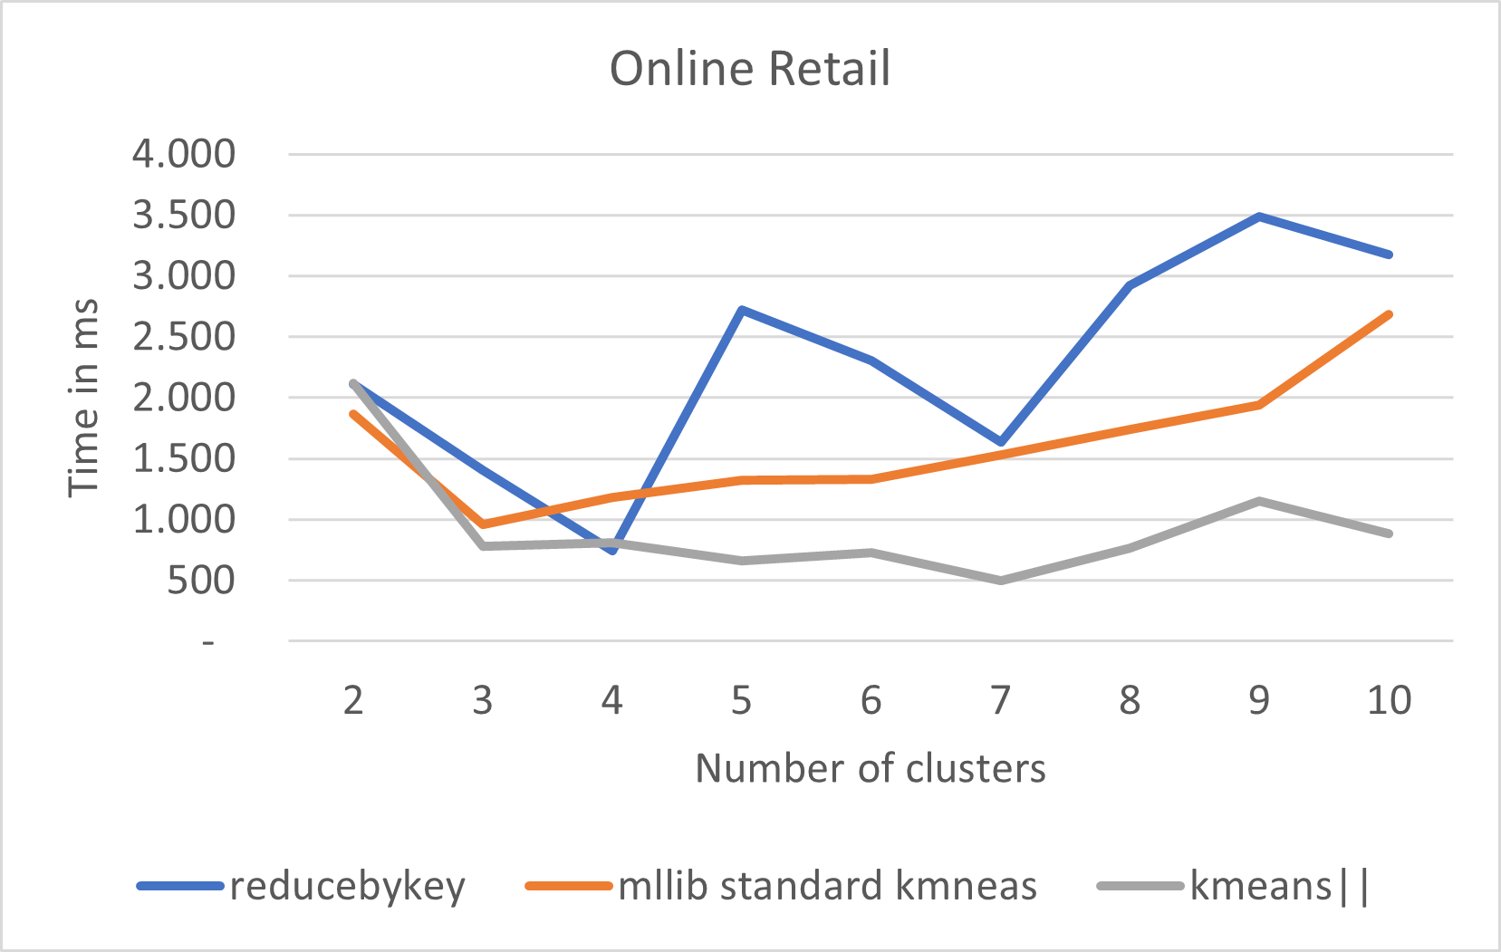
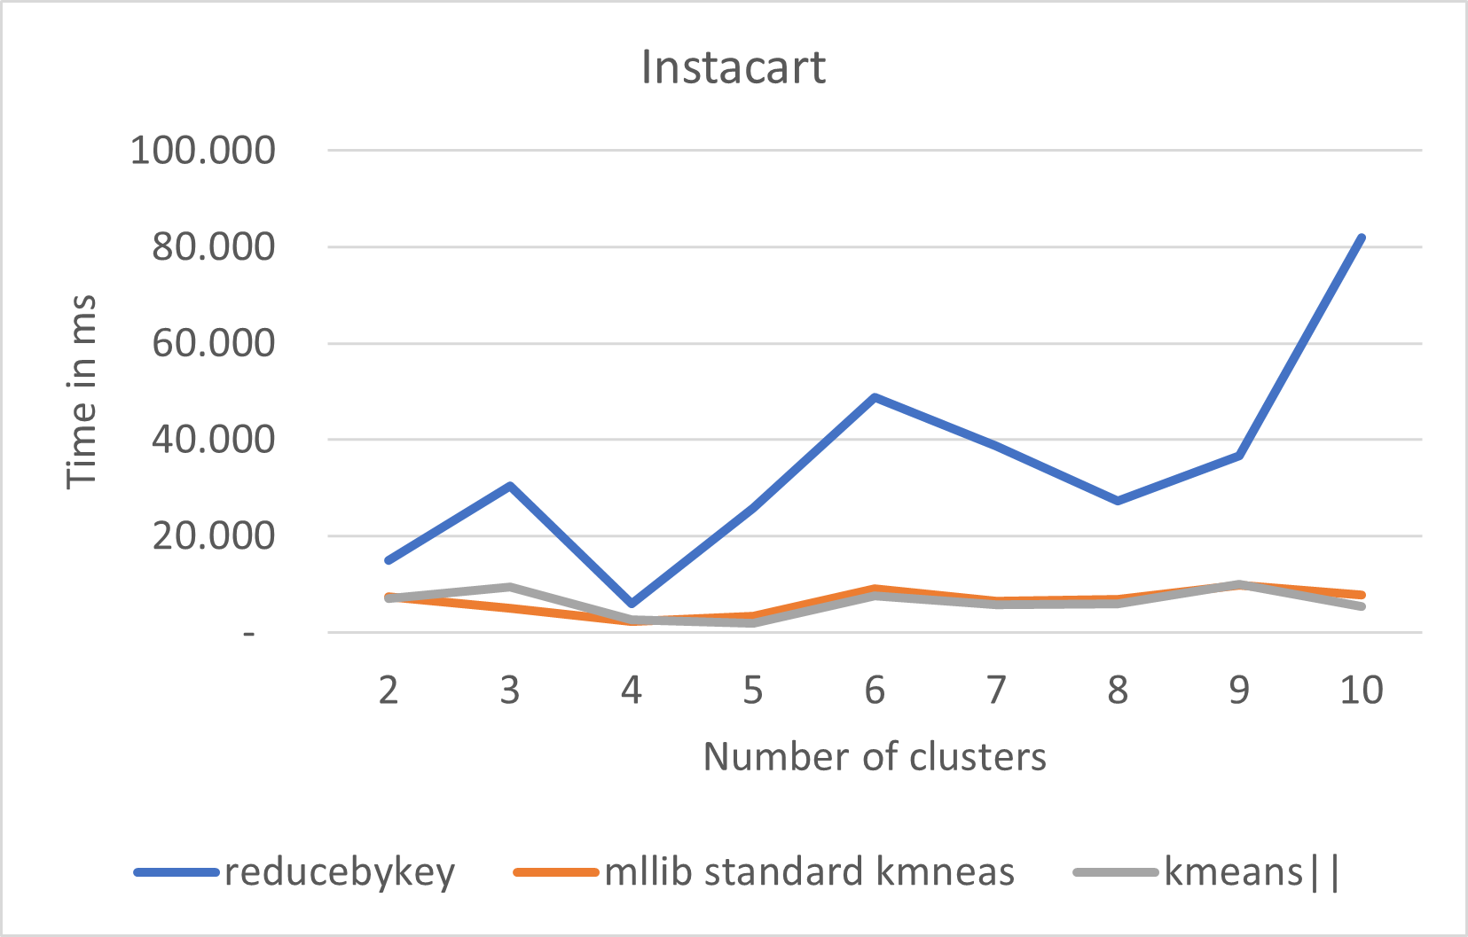
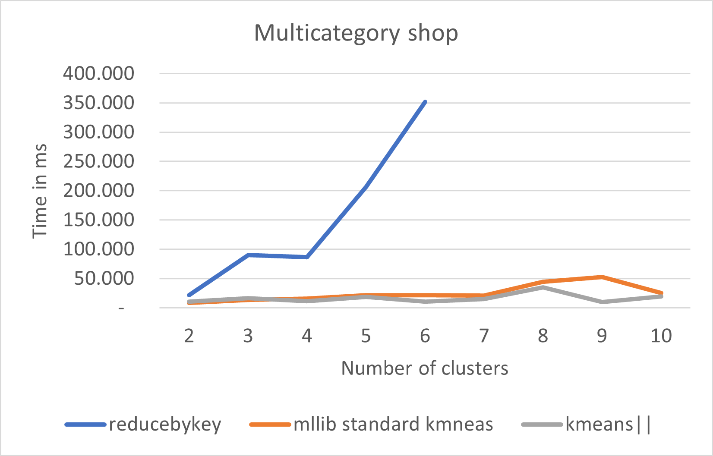
Experiment 5 – KMeans real datasets
Test on real dataset in local mode
The analysis of the algorithm implementations on real data shows similar behaviour, with the MLlib implementations much more efficient.
K-Means|| gets better results w.r.t. standard K-Means, especially in the first and in the last cases:
in case that the points do not form clearly distinct clusters, the better initialization obtained in the first case makes the algorithm converge faster.

Slide 24
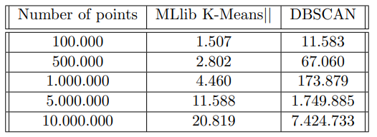
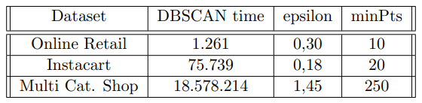
Experiment 6 – DBSCAN analysis
we analysed the performances of DBSCAN algorithm, in local mode, and we compared them with those obtained with K-Means algorithm
DBSCAN require much more time w.r.t. the K-Means|| algorithm. This is not a surprise, we know that K-Means is very popular due to its simplicity and its speed
What we can point out is that the difference increases dramatically as the number of samples increases
For the Mutli Cat. Shop dataset the cost is huge if compared to the synthetic dataset with 10 million of observations, this could be due to:
less separable data
higher number of dimensions, 3 instead of 2
The computational cost of density-based clustering is exponential, while the cost of K-Means|| seems more linear
Synthetic dataset (Time in milliseconds)
Real dataset (Time in milliseconds)

Slide 25
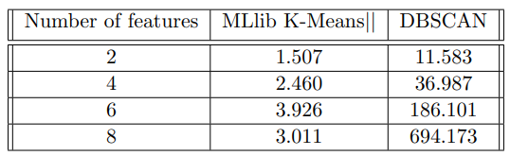
Experiment 7 – Increasing number of features
Analysis of DBSCAN computational time, in local mode, when the number of features increases (dataset with 100.000 points):
Increasing the number of dimensions causes a considerable increase in computational time, instead this is not the case for the K-Means algorithm.
This higher cost is due to the computation of the different non-overlapping boxes that require more resources when there are more dimensions and to the cost associated to the merging of clusters due to points that fall within two boxes borders.
Synthetic dataset (Time in milliseconds)

Slide 26
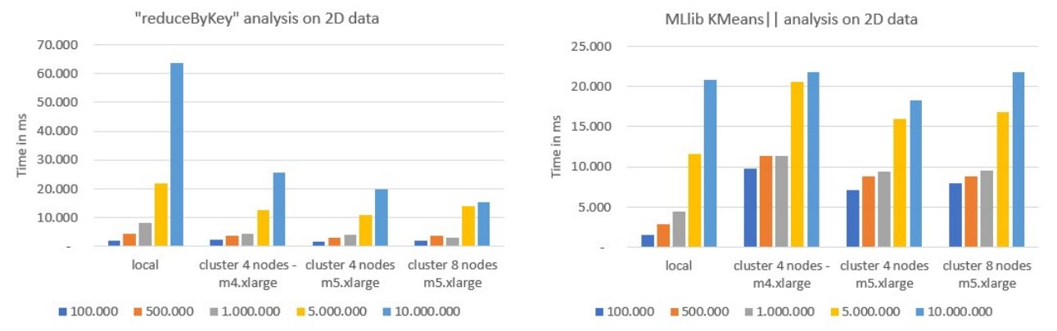




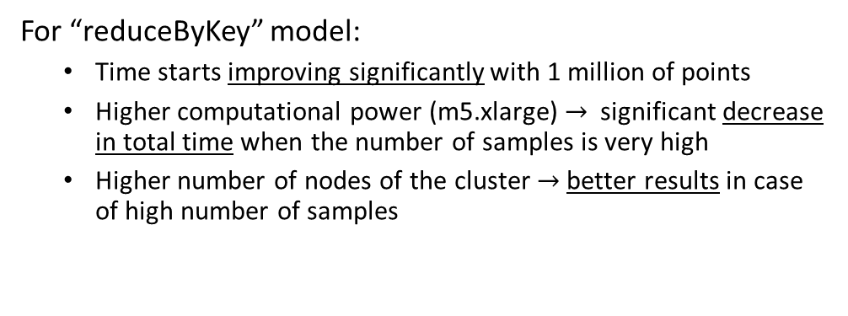
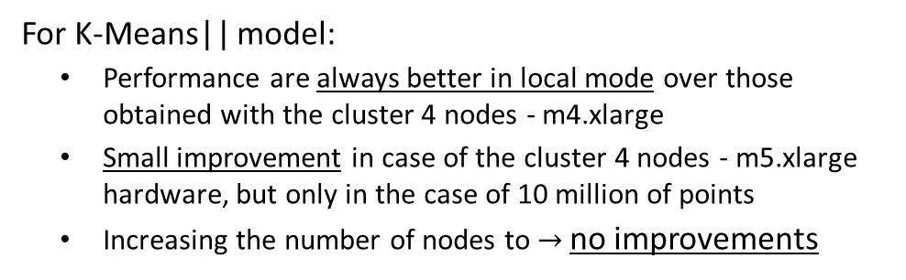
Experiment 8 – K-Means on cloud cluster
For “reduceByKey” model:
Time starts improving significantly with 1 million of points
Higher computational power (m5.xlarge) $→$ significant decrease in total time when the number of samples is very high
Higher number of nodes of the cluster $→$better results in case of high number of samples
For K-Means|| model:
Performance are always better in local mode over those obtained with the cluster 4 nodes - m4.xlarge
Small improvement in case of the cluster 4 nodes - m5.xlarge hardware, but only in the case of 10 million of points
Increasing the number of nodes to $→$no improvements
The analysis on synthetic datasets reveal that for small dataset is better to work in local mode, especially in the case of K-Means||
The "reduceByKey" model with a cluster of 8 nodes and m5.xlarge hardware gets the better results in the case of 10 million samples, so it seems to scale better than MLlib model.
Synthetic datasets

Slide 27
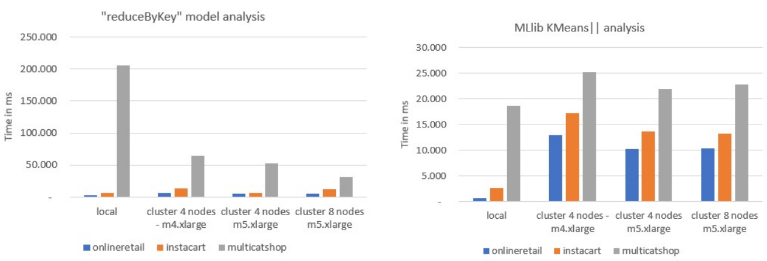
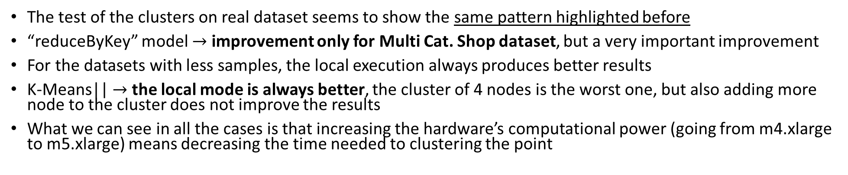
Experiment 9 - K-Means on cloud cluster
The test of the clusters on real dataset seems to show the same pattern highlighted before
“reduceByKey” model $→$ improvement only for Multi Cat. Shop dataset, but a very important improvement
For the datasets with less samples, the local execution always produces better results
K-Means|| $→$ the local mode is always better, the cluster of 4 nodes is the worst one, but also adding more node to the cluster does not improve the results
What we can see in all the cases is that increasing the hardware’s computational power (going from m4.xlarge to m5.xlarge) means decreasing the time needed to clustering the point
Real datasets

Slide 28
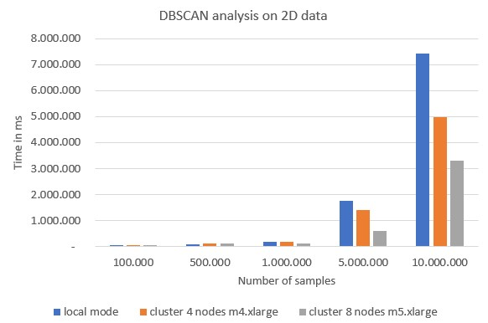
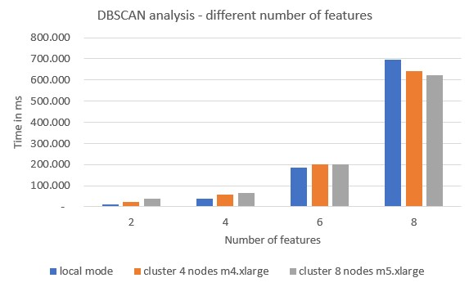
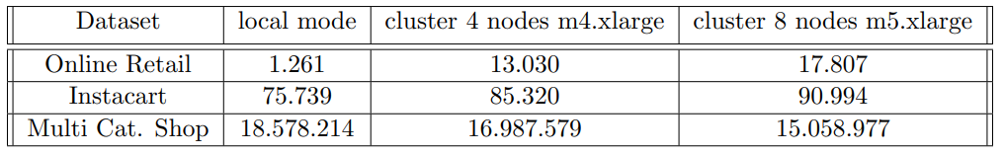
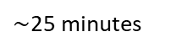
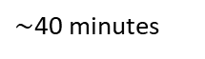
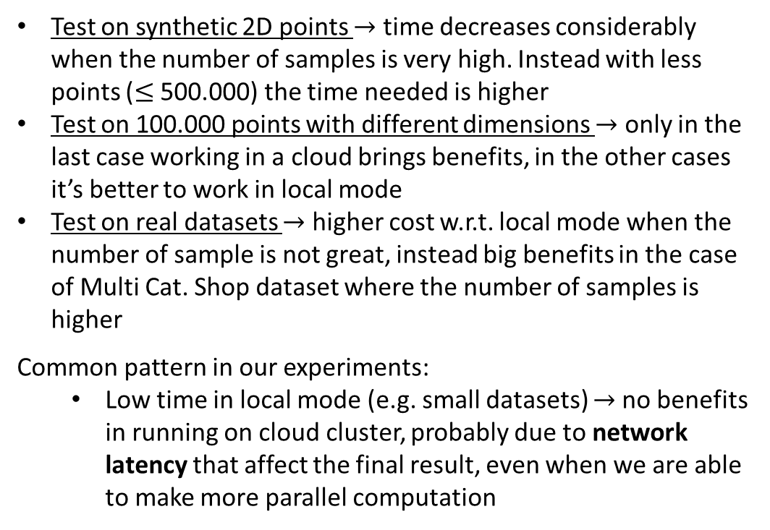
Experiment 10 – DBSCAN on cloud cluster
$\sim$40 minutes
Test on synthetic 2D points $→$ time decreases considerably when the number of samples is very high. Instead with less points ($≤$ 500.000) the time needed is higher
Test on 100.000 points with different dimensions $→$ only in the last case working in a cloud brings benefits, in the other cases it’s better to work in local mode
Test on real datasets $→$ higher cost w.r.t. local mode when the number of sample is not great, instead big benefits in the case of Multi Cat. Shop dataset where the number of samples is higher
Common pattern in our experiments:
Low time in local mode (e.g. small datasets) $→$no benefits in running on cloud cluster, probably due to network latency that affect the final result, even when we are able to make more parallel computation
$\sim$25 minutes
DBSCAN analysis on real datasets (Time in milliseconds)

Slide 29
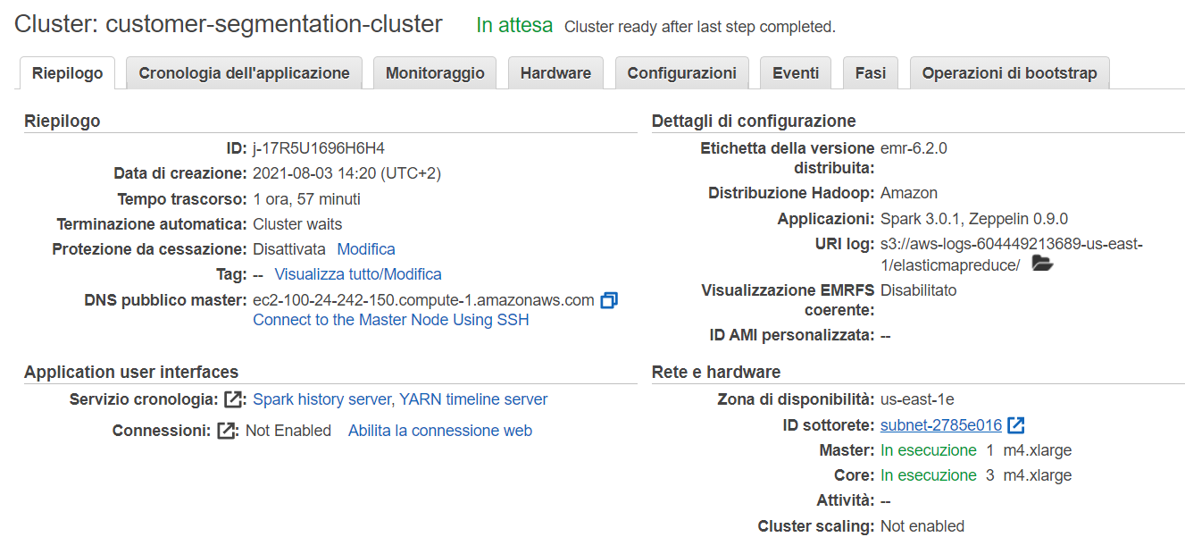
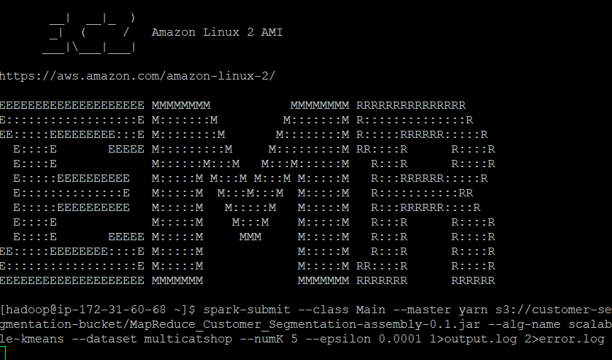
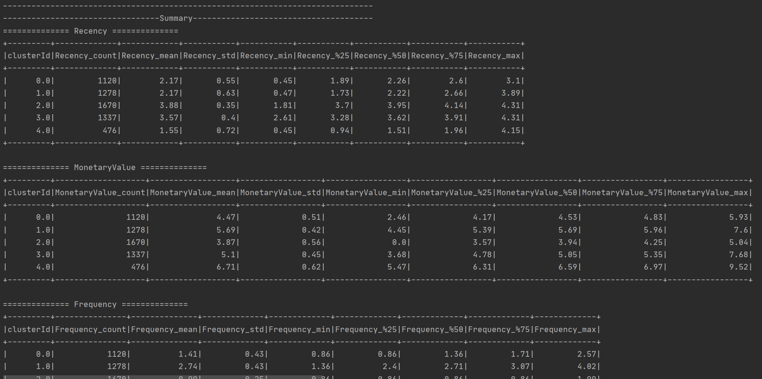



Deploy
Create a cluster using Aws GUI
Connect to the cluster through SSH
Submit application
Analyse results on the console or on pair-plot or using csv file and jupyter notebook
Results analysis:

Slide 30



Online Retail results example
Elbow line plot
K-Means
Elbow method to choose the right number of clusters in case of K-Means
The results in the two cases are very different from each other, but it’s clear that K-Means produces results more useful for the task of customer segmentation
In the second case the segment with cluster Id equal to 0 are the samples treated as outliers by the model, to include this in one clusters the parameter needs to be increased, but increasing that param causes the merging of the other clusters, resulting in one single big cluster that is useless in our analysis
In the case of DBSCAN the extreme values for the features make that the samples are treated as outliers
DBSCAN

Slide 31




Online Retail results example
Recency
Frequency
Monetary Value
Cluster 0 (Red): customers that make low-cost purchases, with a relatively low frequency, but above 1, and made their last purchase more recently, so they can be newest users. We can categorize them in Promising.
Marketing $→$ Start building relationships with these customers by providing onboarding support and special offers to increase their visits.
Cluster 1 (Orange): users with a decent spend, but not as frequent as the cluster 4. We can categorize them in Loyal customers.
Marketing $→$ Advocacy programs and reviews are common strategies. Lastly, consider rewarding these customers with Free Shipping or other like benefits.
Cluster 2 (Yellow): customers with lower frequency and monetary value and higher recency. These are Lost cheap customers.
Marketing $→$Don’t spend too much trying to re-acquire them
Cluster with id 3 (Light Green) represents users that purchase medium amounts, with a relatively low frequency and not very recent. We can categorize them in Almost lost.
Marketing $→\text{Aggressive} \text{price} \text{incentives} \text{and} \text{new} \text{products} \text{launches}$
Cluster 4 (Green): customers who shop often and with high amount, at the same time is the cluster with less amount of customers. These are surely the Best/Core customers.
Marketing $→\text{No} \text{price} \text{incentives}\text{, }\text{new} \text{products} \text{or} \text{loyalty} \text{programs}\text{. }\text{Focus} \text{on} \text{value} \text{added} \text{offers} \text{through} \text{product} \text{recommendations} \text{based} \text{on} \text{previous} \text{purchase}$s

Slide 32
Conclusions
About cloud executions:
MLlib K-Means implementations are very efficient, also when working in local mode. However there is no clear benefit in run it on a cluster, also when the amount of data is great. This could be due to the fact that the time needed by the algorithms is very low and the latency of the network could lead to worst performance
No great difference in terms of time between Mllib Standard K-Means and K-Means||. The better initialization given by the K-Means|| requires more computation and does not lead to great improvements in terms of total time, even if it is worth pointing out that the main advantage of this implementation is the better quality of the final solution
MLlib's implementations also show that more machines doesn't mean always faster computations, trade-off between more parallel computation and more cost of data management (e.g. more shuffling)
"by-hand" implementation of K-Means is clearly the less efficient if we look to the local executions, but it seems more scalable.
A more complex algorithm, such as DBSCAN (it requires exponential time when number of samples or number of features increases), has more benefits from the distributed computation through a cluster of nodes. The difference become huge when the number of samples increases, the time needed to solve the task requires a few hours less
Therefore, with complex algorithm is very useful to scale the computation on a cluster of node, with more simple and fast algorithms, like K-Means, it seems to be not so helpful unless you have hundreds of millions of data

Slide 33
Conclusions
About customer segmentation:
DBSCAN seems not to be a suitable algorithm for customer segmentation, it's better to use other algorithms, such as K-Means, that do not classify samples as noise and produce better results when the data are not clearly separable, as in our experiments
These kind of advanced algorithms are very useful to get insights about grouping in an easy and fast way. Groups made in an automated ways can be useful to discover pattern that marketers might find difficulty discovering on their own
RFM model seems a valuable tool, each group of customers identified has precise characteristics and we are able to define precise marketing strategies to address them in the most effective way.
However, when developing or creating a marketing plan, marketing experts or decision makers should not rely on this analysis alone. Different options and analysis should be considered. Additionally, insights from customer feedback and results of previous marketing plans should be combined in order to decide the best way to understand and communicate with customers.
Customer Segmentation based on RFM model and ML algorithms can be considered as a simple and fast way to get additional information useful to the business decisions

